Slide 1
Control Run New Housing(PC mold)
of T99X171.00 Product
Prepare by: ME - Huy
Date: April 24th 2023

Slide 2

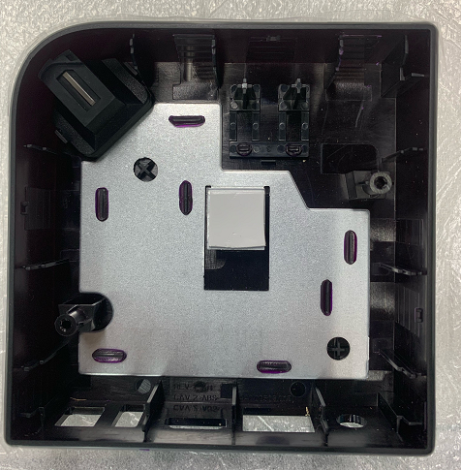
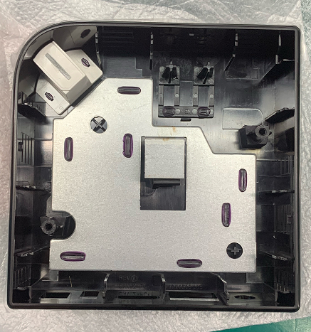
Control Run new housing of T99X171 product
Measure the width, length, height of new housing (PC mold)
New top case ASS'Y 95.05*95.05 (PN: 441.00896.035)
Inside the top case of new housing don’t have sponge, so need to paste sponge (P/N: 484.00300.005) on the housing as old housing (PN: 441.00896.015).
P/N |  | Logo | In Housing | Material
441.00896.025 | New mold |  |  | MABS
441.00896.035 | PC mold |  |  | MABS
Top cover Samples | Width 95.05±0.2mm | Length 95.05±0.2mm | Height 25±0.15mm
#1 | 95.06 | 95.00 | 24.96
#2 | 95.11 | 95.02 | 24.93
#3 | 95.03 | 95.02 | 24.98
#4 | 95.13 | 95.08 | 24.96
#5 | 95.08 | 94.96 | 25.04
#6 | 95.09 | 95.11 | 25.02
#7 | 95.11 | 95.07 | 25.05
#8 | 95.12 | 95.06 | 24.93
#9 | 94.98 | 94.98 | 25.01
Result : The width, length, height of 9pcs incoming material are in Spec.

Slide 3
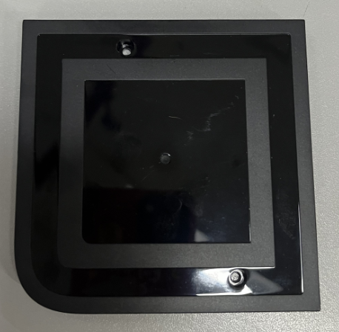
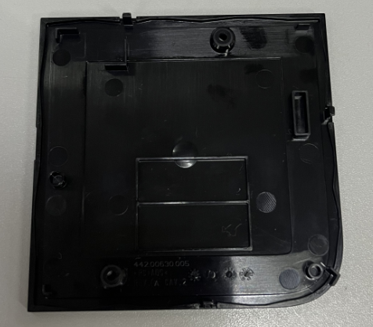
Control Run new housing of T99X171 product
Measure the width, length of new housing (New mold)
Bottom case 90.79*90.79*7.49 (PN: 442.00630.015)
P/N |  | Top side | Bottom side | Material
442.00630.015 | New mold |  |  | ABS
Bottom cover Samples | Width 90.79±0.2mm | Length 90.79±0.2mm
#1 | 90.80 | 90.86
#2 | 90.75 | 90.81
#3 | 90.75 | 90.74
#4 | 90.78 | 90.77
#5 | 90.84 | 90.82
#6 | 90.81 | 90.84
#7 | 90.83 | 90.82
#8 | 90.79 | 90.85
#9 | 90.81 | 90.80
Result : The width, length of 9pcs incoming material are in Spec.

Slide 4
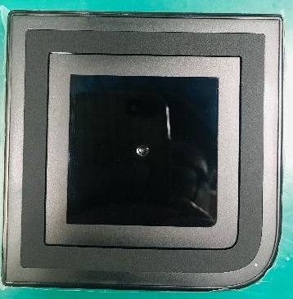
Control Run new housing of T99X171 product
Measure the gap between bottom case and top case of 10 samples units
New top case ASS'Y 95.05*95.05 (PN: 441.00896.035)
Old bottom case ASS'Y 90.79*90.79*7.49 (PN: 442.00630.015)
Sample | Side 1 | Side 2 | Side 3 | Side 4 | Spec
#1 | 0.1mm | 0.2mm | 0.2mm | 0.1mm | =/<0.4mm
#2 | 0.1mm | 0.2mm | 0.15mm | 0.15mm
#3 | 0.15mm | 0.15mm | 0.2mm | 0.1mm
#4 | 0.1mm | 0.15mm | 0.15mm | 0.1mm
#5 | 0.15mm | 0.2mm | 0.2mm | 0.1mm
#6 | 0.15mm | 0.15mm | 0.2mm | 0.15mm
#7 | 0.1mm | 0.2mm | 0.15mm | 0.1mm
#8 | 0.1mm | 0.15mm | 0.2mm | 0.15mm
#9 | 0.15mm | 0.2mm | 0.2mm | 0.1mm
#10 | 0.1mm | 0.2mm | 0.15mm | 0.1mm
Side 2
Side 1
Side 3
Side 4
Result : 10pcs are assembled normal. The Gap between bottom case and top case is in Spec.

Slide 5
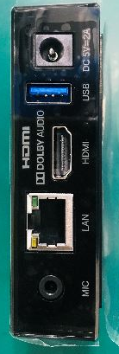
Control Run new housing of T99X171 product
Measure the gap between top case and connection ports of 10 samples units
New top case ASS'Y 95.05*95.05 (PN: 441.00896.035)
LAN, HDMI, USB, DC ports
Sample | GAP LAN | GAP HDMI | GAP USB | GAP DC | Spec
#1 | 0.25 | 0.2 | 0.2 | 0.25 | 0.5mm
#2 | 0.2 | 0.2 | 0.2 | 0.2
#3 | 0.2 | 0.2 | 0.25 | 0.2
#4 | 0.25 | 0.25 | 0.25 | 0.2
#5 | 0.25 | 0.2 | 0.2 | 0.25
#6 | 0.2 | 0.2 | 0.25 | 0.2
#7 | 0.25 | 0.25 | 0.25 | 0.25
#8 | 0.25 | 0.25 | 0.2 | 0.2
#9 | 0.2 | 0.25 | 0.2 | 0.2
#10 | 0.2 | 0.2 | 0.2 | 0.25
Summary : 10pcs are assembled normal. The gap between housing and connection ports is in Spec.

Slide 6
Control Run new housing of T99X171 product
Visual inspection 100pcs control run on production line.
Model | Visual inspection Q’ty | Pass Q’ty | Failure Q’ty | Result
T99X171 | 100 | 100 | 0 | Pass
Result : No found any visual inspection issue..

Slide 7
Conclusion
IQC measure the width, length, height of 9pcs of incoming material: Pass
IQC measure the width, length of 9pcs of incoming material: Pass
ME measure the gap between bottom case and top case of 10 samples units: Pass
ME measure the gap between top case and connection ports of 10 samples units: Pass
Visual inspection 100pcs control run on production line: Pass
Result: the control run result is PASS, we can use new housing of NWE.

